Slide 1
From Global Pairwise DNA Alignment to Whole Genome Alignment
Tim Read
IBS574
2/17/2013

Slide 2
Pairwise Alignment
Whole Genome Alignment (WGA)
Reference Mapping
De novo assembly

Slide 3
Pairwise Sequence Alignment
AATGTGCCTTGTTATA
||| ||| |||||
AAT---CCTAGTTAT-
How to score an alignment?
How to find the best alignment?

Slide 4
Hamming distance
Simple metric to compare sequences (DNA, amino acids, text, binary etc)
How many substitutions between strings?
Or: How many substitutions necessary to change string to string 2?

Slide 5
What is the Hamming distance?
AATGTGCCTTGTTATA
||| ||| |||||
AAT---CCTAGTTAT-

Slide 6
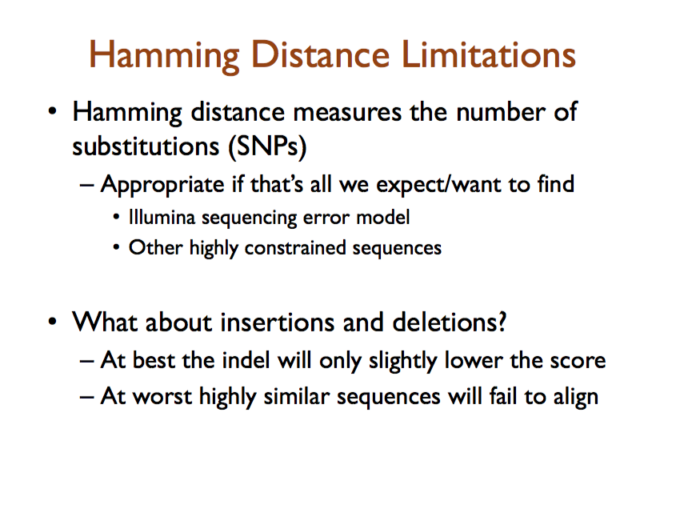
M. Schatz

Slide 7
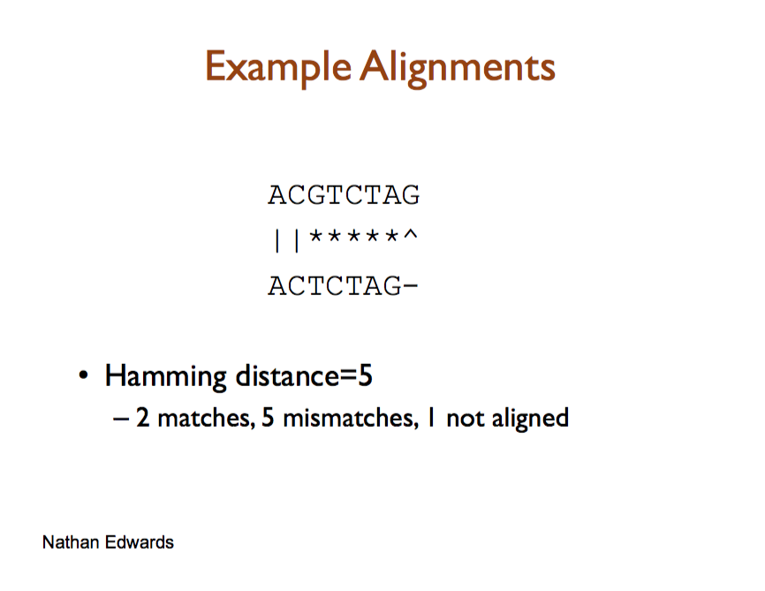

Slide 8
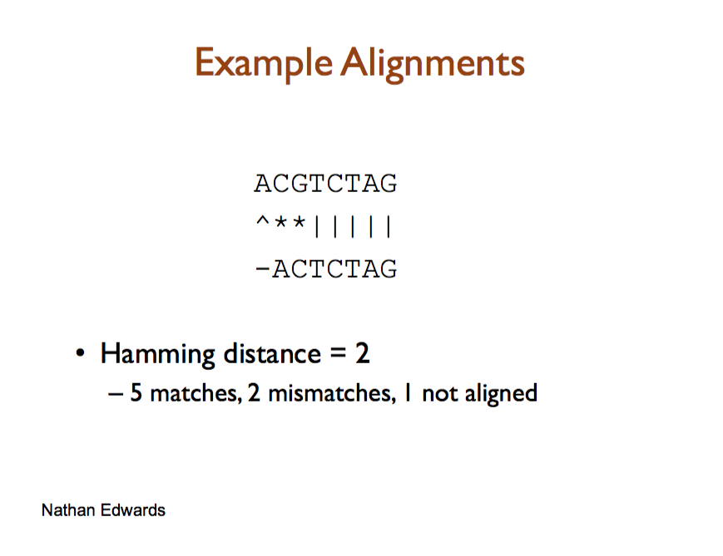

Slide 9
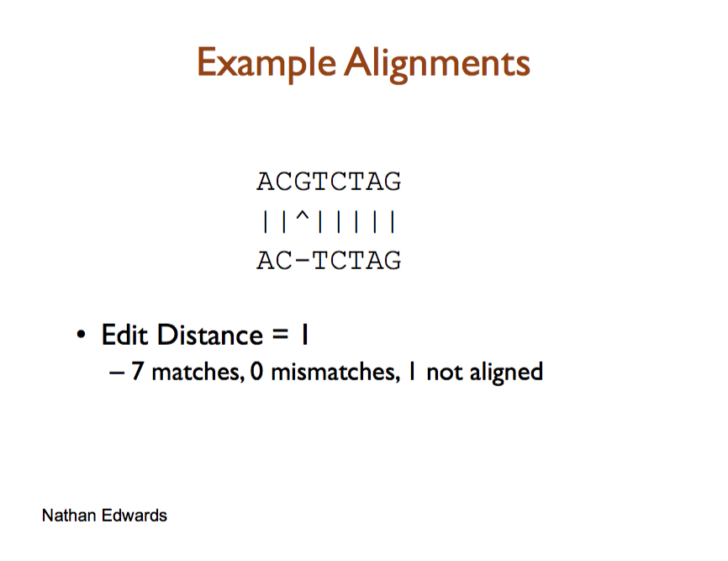

Slide 10
The problem
How to find the arrange of sequences that give the minimum distance?
(Think about the assumptions behind looking for the minimum distance a little)

Slide 11
The Needleman-Wunsch Global Alignment algorithm
Even for relatively short sequences, there are lots of possible alignments
The problem of finding the best possible alignment for 2 sequences was solved by the Needleman-Wunsch algorithm (1970)
The N-W algorithm is proven to find the best alignment of 2 sequences
By the ‘best’ alignment, we mean the alignment that implies the fewest number of substitutions(mutations) in the 2 sequences
Avril Cauglin Sanger Institute

Slide 12
The Needleman-Wunsch algorithm
The Needleman-Wunsch algorithm saves the trouble of assessing all the many possible alignments to find the best one
The N-W algorithm takes time proportion to n² to find the best alignment of two sequences that are both n letters long
In contrast, assessing all possible alignments one-by-one would take time proportional to ( )
2n
n
Avril Cauglin
Notes:
How many times faster is it to find the best alignment for sequences “RQQEP” & “QQESP” using the Needleman-Wunsch algorithm, compared to assessing each possible alignment one-by-one?
The sequence length, n, is 5 here. This means it will take time proportional to n²=25 to find the best alignment using N-W It will take time proportional to ( ) = 252 to find the best alignment by assessing each possible alignment one-by-one. This means that we can find the best alignment about 10 times (=252/25) faster by using N-W.

Slide 13
Technical stuff
n² is much smaller than ( ), so N-W is much faster than assessing all possible alignments one-by-one
eg. for n=11, n²=121, ( )=705432, so N-W is ~5830-fold faster (705432/121) than assessing all alignments
( ) means number of n-element subsets of a k-element set =
= 2n!/(n!)²
2n
n
2n
n
2n
n

Slide 14
To use N-W, we must first define:
A scoring function (σ): defines the score to give to a substitution mutation eg. -1 for a match, -1 for mismatch
A gap penalty: defines the score to give to an insertion or deletion mutation, eg. -1
A recurrence relation: defines what actions we repeat at each iteration (step) of the algorithm:
There are 2 parts to computing the best alignment using the N-W algorithm:
Fill up a matrix (table) T using the recurrence relation
The traceback step : use the filled-in matrix T to work out the best alignment
Avril Cauglin

Slide 15
Scoring functions
We define a scoring function σ(S₁(i), S₂(j)) for pairs of amino acids or nucleotides (S₁(i), S₂(j))
σ(S1(i), S2(j)) is the cost (score) of aligning symbols S1(i) & S2(j)
ie. σ(S1(i), S2(j)) is the cost (score) for a substitution mutation from S1(i) → S2(j)
A simple scoring function σ is a score of +1 for matches, and -1 for mismatches
A convenient way of representing many scoring functions is a substitution matrix
Avril Cauglin
Notes:
This can be written as: (the symbol means ‘for all’)
σ(a,b) = +1 and σ(a,b) = -1

Slide 16
Letter b
 | A | R | N | D | C | Q | E | G | H | I | L | K | M | F | P | S | T | W | Y | V
A | 1 | -1 | -1 | -1 | -1 | -1 | -1 | -1 | -1 | -1 | -1 | -1 | -1 | -1 | -1 | -1 | -1 | -1 | -1 | -1
R | -1 | 1 | -1 | -1 | -1 | -1 | -1 | -1 | -1 | -1 | -1 | -1 | -1 | -1 | -1 | -1 | -1 | -1 | -1 | -1
N | -1 | -1 | 1 | -1 | -1 | -1 | -1 | -1 | -1 | -1 | -1 | -1 | -1 | -1 | -1 | -1 | -1 | -1 | -1 | -1
D | -1 | -1 | -1 | 1 | -1 | -1 | -1 | -1 | -1 | -1 | -1 | -1 | -1 | -1 | -1 | -1 | -1 | -1 | -1 | -1
C | -1 | -1 | -1 | -1 | 1 | -1 | -1 | -1 | -1 | -1 | -1 | -1 | -1 | -1 | -1 | -1 | -1 | -1 | -1 | -1
Q | -1 | -1 | -1 | -1 | -1 | 1 | -1 | -1 | -1 | -1 | -1 | -1 | -1 | -1 | -1 | -1 | -1 | -1 | -1 | -1
E | -1 | -1 | -1 | -1 | -1 | -1 | 1 | -1 | -1 | -1 | -1 | -1 | -1 | -1 | -1 | -1 | -1 | -1 | -1 | -1
G | -1 | -1 | -1 | -1 | -1 | -1 | -1 | 1 | -1 | -1 | -1 | -1 | -1 | -1 | -1 | -1 | -1 | -1 | -1 | -1
H | -1 | -1 | -1 | -1 | -1 | -1 | -1 | -1 | 1 | -1 | -1 | -1 | -1 | -1 | -1 | -1 | -1 | -1 | -1 | -1
I | -1 | -1 | -1 | -1 | -1 | -1 | -1 | -1 | -1 | 1 | -1 | -1 | -1 | -1 | -1 | -1 | -1 | -1 | -1 | -1
L | -1 | -1 | -1 | -1 | -1 | -1 | -1 | -1 | -1 | -1 | 1 | -1 | -1 | -1 | -1 | -1 | -1 | -1 | -1 | -1
K | -1 | -1 | -1 | -1 | -1 | -1 | -1 | -1 | -1 | -1 | -1 | 1 | -1 | -1 | -1 | -1 | -1 | -1 | -1 | -1
M | -1 | -1 | -1 | -1 | -1 | -1 | -1 | -1 | -1 | -1 | -1 | -1 | 1 | -1 | -1 | -1 | -1 | -1 | -1 | -1
F | -1 | -1 | -1 | -1 | -1 | -1 | -1 | -1 | -1 | -1 | -1 | -1 | -1 | 1 | -1 | -1 | -1 | -1 | -1 | -1
P | -1 | -1 | -1 | -1 | -1 | -1 | -1 | -1 | -1 | -1 | -1 | -1 | -1 | -1 | 1 | -1 | -1 | -1 | -1 | -1
S | -1 | -1 | -1 | -1 | -1 | -1 | -1 | -1 | -1 | -1 | -1 | -1 | -1 | -1 | -1 | 1 | -1 | -1 | -1 | -1
T | -1 | -1 | -1 | -1 | -1 | -1 | -1 | -1 | -1 | -1 | -1 | -1 | -1 | -1 | -1 | -1 | 1 | -1 | -1 | -1
W | -1 | -1 | -1 | -1 | -1 | -1 | -1 | -1 | -1 | -1 | -1 | -1 | -1 | -1 | -1 | -1 | -1 | 1 | -1 | -1
Y | -1 | -1 | -1 | -1 | -1 | -1 | -1 | -1 | -1 | -1 | -1 | -1 | -1 | -1 | -1 | -1 | -1 | -1 | 1 | -1
V | -1 | -1 | -1 | -1 | -1 | -1 | -1 | -1 | -1 | -1 | -1 | -1 | -1 | -1 | -1 | -1 | -1 | -1 | -1 | 1
Letter b
 | A | C | G | T
A | +1 | -1 | -1 | -1
C | -1 | +1 | -1 | -1
G | -1 | -1 | +1 | -1
T | -1 | -1 | -1 | +1
Letter a
Letter a
Avril Cauglin

Slide 17
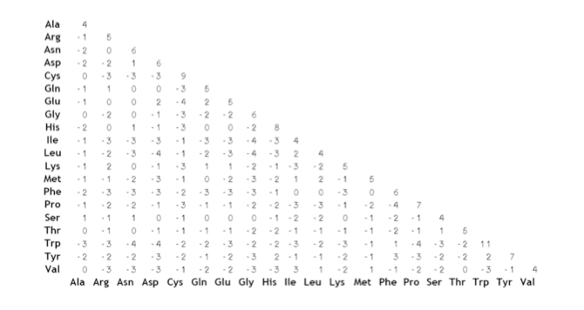
Another example – Blosum62
These example matrices are for amino acids but there are also simpler matrices for nucleotides

Slide 18
N-W: Initialising table T
To align 2 sequences S₁ & S₂ of lengths m & n, N-W starts by building a table T with m+1 columns & n+1 rows:
eg. for S₁=‘TGGTG’ & S₂=‘ATCGT’, m=5 and n=5:
We number the columns i=0,1,2,....m
We number the rows j=0,1,2,...n
 |  | T | G | G | T | G
A
T
C
G
T
Table T
i=0
i=1
i=2
i=3
i=4
i=5
 |  | T | G | G | T | G
A
T
C
G
T
j=0
j=1
j=2
j=3
j=4
j=5
Avril Cauglin

Slide 19
T(i, j) is the cell at the intersection of column i and row j
eg. for S₁=‘TGGTG’ & S₂=‘ATCGT’, m=5 and n=5:
The N-W algorithm starts by initialising (setting the initial value of) T(0,0) to zero:
i=0
i=1
i=2
i=3
i=4
i=5
 |  | T | G | G | T | G
A
T
C
G
T
j=0
j=1
Table T
T(3,2)
j=2
j=3
j=4
j=5
 |  | T | G | G | T | G
 | 0
A
T
C
G
T
Avril Cauglin

Slide 20
The table T is then filled in using the recurrence relation:
T(i-1, j-1) + σ(S₁(i), S₂(j))
T(i-1, j) + gap penalty
T(i, j-1) + gap penalty
This means that the value in cell T(i, j) is set to be the maximum of the three possibilities 1 , 2 , 3
T(i-1, j-1) is the value in the previous column & row
T(i-1, j) is the value in the previous column & same row
T(i, j-1) is the value in the same column & previous row
i=0
i=1
i=2
i=3
i=4
i=5
 |  | T | G | G | T | G
A
T
C
G
T
 |  | T | G | G | T | G
A
T
C
G
T
 |  | T | G | G | T | G
A
T
C
G
T
 |  | T | G | G | T | G
A
T
C
G
T
j=0
T(i, j-1) = T(3,1)
j=1
T(i-1, j-1) = T(2,1)
Table T
T(i, j) = T(3,2)
j=2
j=3
T(i-1, j) = T(2,2)
j=4
j=5
Avril Cauglin

Slide 21
For example, say we decide to use +1 for matches, -1 for mismatches, and -2 for an insertion/deletion (gap)
The N-W algorithm starts by initialising (setting the initial value of) T(0,0) to zero
We next calculate the value of T(1, 0)
The value of T(1,0) is set to the maximum of 3 possibilities:
T(i-1, j-1) + σ(S₁(i), S₂(j))
T(i-1, j) + gap penalty
T(i, j-1) + gap penalty
We calculate this to be -2, so set T(1, 0) to -2
We record which previous cell was used to set the value of T(1, 0) :
Not defined here
= 0 – 2 = -2
Not defined here
 |  | T | G | G | T | G
 | 0
A
T
C
G
T
 |  | T | G | G | T | G
 | 0 | ?
A
T
C
G
T
 |  | T | G | G | T | G
 | 0 | -2
A
T
C
G
T
Avril Cauglin

Slide 22
We next calculate the value of T(2, 0)
The value of T(2,0) is set to the maximum of 3 possibilities:
T(i-1, j-1) + σ(S₁(i), S₂(j))
T(i, j) = max T(i-1, j) + gap penalty
T(i, j-1) + gap penalty
We calculate this to be -4, so set T(2, 0) to -4
We record which previous cell was used to set the value of T(2, 0) :
Not defined here
= -2 – 2 = -4
Not defined here
 |  | T | G | G | T | G
 | 0 | -2
A
T
C
G
T
 |  | T | G | G | T | G
 | 0 | -2 | ?
A
T
C
G
T
 |  | T | G | G | T | G
 | 0 | -2 | -4
A
T
C
G
T
Avril Cauglin

Slide 23
We next calculate the value of T(3, 0)
The value of T(3,0) is set to the maximum of 3 possibilities:
T(i-1, j-1) + σ(S₁(i), S₂(j))
T(i, j) = max T(i-1, j) + gap penalty
T(i, j-1) + gap penalty
We calculate this to be -6, so set T(3, 0) to -6
We record which previous cell was used to set the value of T(3, 0) :
Not defined here
= -4 – 2 = -6
Not defined here
 |  | T | G | G | T | G
 | 0 | -2 | -4
A
T
C
G
T
 |  | T | G | G | T | G
 | 0 | -2 | -4 | ?
A
T
C
G
T
 |  | T | G | G | T | G
 | 0 | -2 | -4 | -6
A
T
C
G
T
Avril Cauglin

Slide 24
We next calculate the value of T(4, 0)
The value of T(4,0) is set to the maximum of 3 possibilities:
T(i-1, j-1) + σ(S₁(i), S₂(j))
T(i, j) = max T(i-1, j) + gap penalty
T(i, j-1) + gap penalty
We calculate this to be -8, so set T(4, 0) to -8
We record which previous cell was used to set the value of T(4, 0) :
Not defined here
= -6 – 2 = -8
Not defined here
 |  | T | G | G | T | G
 | 0 | -2 | -4 | -6
A
T
C
G
T
 |  | T | G | G | T | G
 | 0 | -2 | -4 | -6 | ?
A
T
C
G
T
 |  | T | G | G | T | G
 | 0 | -2 | -4 | -6 | -8
A
T
C
G
T
Avril Cauglin

Slide 25
We next calculate the value of T(5, 0)
The value of T(5,0) is set to the maximum of 3 possibilities:
T(i-1, j-1) + σ(S₁(i), S₂(j))
T(i, j) = max T(i-1, j) + gap penalty
T(i, j-1) + gap penalty
We calculate this to be -10, so set T(5, 0) to -10
We record which previous cell was used to set the value of T(5, 0) :
Not defined here
= -8 – 2 = -10
Not defined here
 |  | T | G | G | T | G
 | 0 | -2 | -4 | -6 | -8
A
T
C
G
T
 |  | T | G | G | T | G
 | 0 | -2 | -4 | -6 | -8 | ?
A
T
C
G
T
 |  | T | G | G | T | G
 | 0 | -2 | -4 | -6 | -8 | -10
A
T
C
G
T
Avril Cauglin

Slide 26
We next calculate the value of T(0, 1)
The value of T(0,1) is set to the maximum of 3 possibilities:
T(i-1, j-1) + σ(S₁(i), S₂(j))
T(i, j) = max T(i-1, j) + gap penalty
T(i, j-1) + gap penalty
We calculate this to be -2, so set T(0, 1) to -2
We record which previous cell was used to set the value of T(0, 1) :
Not defined here
Not defined here
= 0 – 2 = -2
 |  | T | G | G | T | G
 | 0 | -2 | -4 | -6 | -8 | -10
A | ?
T
C
G
T
 |  | T | G | G | T | G
 | 0 | -2 | -4 | -6 | -8 | -10
A | -2
T
C
G
T
 |  | T | G | G | T | G
 | 0 | -2 | -4 | -6 | -8 | -10
A
T
C
G
T
Avril Cauglin

Slide 27
We next calculate the value of T(1, 1)
The value of T(1,1) is set to the maximum of 3 possibilities:
T(i-1, j-1) + σ(S₁(i), S₂(j))
T(i, j) = max T(i-1, j) + gap penalty
T(i, j-1) + gap penalty
We calculate this to be -1, so set T(1, 1) to -1
We record which previous cell was used to set the value of T(1, 1) :
= 0 – 1 = -1
= -2 -2 = -4
= -2 -2 = -4
 |  | T | G | G | T | G
 | 0 | -2 | -4 | -6 | -8 | -10
A | -2 | ?
T
C
G
T
 |  | T | G | G | T | G
 | 0 | -2 | -4 | -6 | -8 | -10
A | -2 | -1
T
C
G
T
 |  | T | G | G | T | G
 | 0 | -2 | -4 | -6 | -8 | -10
A | -2
T
C
G
T
Avril Cauglin

Slide 28
We next calculate the value of T(2, 1)
The value of T(2,1) is set to the maximum of 3 possibilities:
T(i-1, j-1) + σ(S₁(i), S₂(j))
T(i, j) = max T(i-1, j) + gap penalty
T(i, j-1) + gap penalty
We calculate this to be -3, so set T(2, 1) to -3
We record which previous cells were used to set the value of T(2, 1) (two different cells here):
= -2 -1 = -3
= -1 -2 = -3
= -4 -2 = -6
 |  | T | G | G | T | G
 | 0 | -2 | -4 | -6 | -8 | -10
A | -2 | -1 | ?
T
C
G
T
 |  | T | G | G | T | G
 | 0 | -2 | -4 | -6 | -8 | -10
A | -2 | -1 | -3
T
C
G
T
 |  | T | G | G | T | G
 | 0 | -2 | -4 | -6 | -8 | -10
A | -2 | -1
T
C
G
T

Slide 29
We next calculate the value of T(3, 1)
The value of T(3,1) is set to the maximum of 3 possibilities:
T(i-1, j-1) + σ(S₁(i), S₂(j))
T(i, j) = max T(i-1, j) + gap penalty
T(i, j-1) + gap penalty
We calculate this to be -5, so set T(3, 1) to -5
We record which previous cells were used to set the value of T(3, 1) (two different cells here):
= -4 -1 = -5
= -3 -2 = -5
= -6 -2 = -8
 |  | T | G | G | T | G
 | 0 | -2 | -4 | -6 | -8 | -10
A | -2 | -1 | -3 | ?
T
C
G
T
 |  | T | G | G | T | G
 | 0 | -2 | -4 | -6 | -8 | -10
A | -2 | -1 | -3 | -5
T
C
G
T
 |  | T | G | G | T | G
 | 0 | -2 | -4 | -6 | -8 | -10
A | -2 | -1 | -3
T
C
G
T
Avril Cauglin

Slide 30
We next calculate the value of T(4, 1)
The value of T(4,1) is set to the maximum of 3 possibilities:
T(i-1, j-1) + σ(S₁(i), S₂(j))
T(i, j) = max T(i-1, j) + gap penalty
T(i, j-1) + gap penalty
We calculate this to be -7, so set T(4, 1) to -7
We record which previous cells were used to set the value of T(4, 1) (two different cells here):
= -6 -1 = -7
= -5 -2 = -7
= -8 -2 = -10
 |  | T | G | G | T | G
 | 0 | -2 | -4 | -6 | -8 | -10
A | -2 | -1 | -3 | -5 | ?
T
C
G
T
 |  | T | G | G | T | G
 | 0 | -2 | -4 | -6 | -8 | -10
A | -2 | -1 | -3 | -5 | -7
T
C
G
T
 |  | T | G | G | T | G
 | 0 | -2 | -4 | -6 | -8 | -10
A | -2 | -1 | -3 | -5
T
C
G
T
Avril Cauglin

Slide 31
We next calculate the value of T(5, 1)
The value of T(5,1) is set to the maximum of 3 possibilities:
T(i-1, j-1) + σ(S₁(i), S₂(j))
T(i, j) = max T(i-1, j) + gap penalty
T(i, j-1) + gap penalty
We calculate this to be -9, so set T(5, 1) to -9
We record which previous cells were used to set the value of T(5, 1) (two different cells here):
= -8 -1 = -9
= -7 -2 = -9
= -10 -2 = -12
 |  | T | G | G | T | G
 | 0 | -2 | -4 | -6 | -8 | -10
A | -2 | -1 | -3 | -5 | -7 | -9
T
C
G
T
 |  | T | G | G | T | G
 | 0 | -2 | -4 | -6 | -8 | -10
A | -2 | -1 | -3 | -5 | -7
T
C
G
T
 |  | T | G | G | T | G
 | 0 | -2 | -4 | -6 | -8 | -10
A | -2 | -1 | -3 | -5 | -7 | ?
T
C
G
T
Avril Cauglin

Slide 32
N-W: the traceback step
When we have filled in the whole of matrix T, it looks like:
In the traceback step we use the filled-in matrix T to work out the best alignment between the two sequences S₁ & S₂
We start at the bottom right cell of matrix T
We then follow the arrow to the previous cell used to calculate the best value for that cell
From there, follow the arrow to the previous cell... and so on..
 |  | T | G | G | T | G
 | 0 | -2 | -4 | -6 | -8 | -10
A | -2 | -1 | -3 | -5 | -7 | -9
T | -4 | -1 | -2 | -4 | -4 | -6
C | -6 | -3 | -2 | -3 | -5 | -5
G | -8 | -5 | -2 | -1 | -3 | -4
T | -10 | -7 | -4 | -3 | 0 | -2
 |  | T | G | G | T | G
 | 0 | -2 | -4 | -6 | -8 | -10
A | -2 | -1 | -3 | -5 | -7 | -9
T | -4 | -1 | -2 | -4 | -4 | -6
C | -6 | -3 | -2 | -3 | -5 | -5
G | -8 | -5 | -2 | -1 | -3 | -4
T | -10 | -7 | -4 | -3 | 0 | -2
 |  | T | G | G | T | G
 | 0 | -2 | -4 | -6 | -8 | -10
A | -2 | -1 | -3 | -5 | -7 | -9
T | -4 | -1 | -2 | -4 | -4 | -6
C | -6 | -3 | -2 | -3 | -5 | -5
G | -8 | -5 | -2 | -1 | -3 | -4
T | -10 | -7 | -4 | -3 | 0 | -2
 |  | T | G | G | T | G
 | 0 | -2 | -4 | -6 | -8 | -10
A | -2 | -1 | -3 | -5 | -7 | -9
T | -4 | -1 | -2 | -4 | -4 | -6
C | -6 | -3 | -2 | -3 | -5 | -5
G | -8 | -5 | -2 | -1 | -3 | -4
T | -10 | -7 | -4 | -3 | 0 | -2
 |  | T | G | G | T | G
 | 0 | -2 | -4 | -6 | -8 | -10
A | -2 | -1 | -3 | -5 | -7 | -9
T | -4 | -1 | -2 | -4 | -4 | -6
C | -6 | -3 | -2 | -3 | -5 | -5
G | -8 | -5 | -2 | -1 | -3 | -4
T | -10 | -7 | -4 | -3 | 0 | -2
 |  | T | G | G | T | G
 | 0 | -2 | -4 | -6 | -8 | -10
A | -2 | -1 | -3 | -5 | -7 | -9
T | -4 | -1 | -2 | -4 | -4 | -6
C | -6 | -3 | -2 | -3 | -5 | -5
G | -8 | -5 | -2 | -1 | -3 | -4
T | -10 | -7 | -4 | -3 | 0 | -2
 |  | T | G | G | T | G
 | 0 | -2 | -4 | -6 | -8 | -10
A | -2 | -1 | -3 | -5 | -7 | -9
T | -4 | -1 | -2 | -4 | -4 | -6
C | -6 | -3 | -2 | -3 | -5 | -5
G | -8 | -5 | -2 | -1 | -3 | -4
T | -10 | -7 | -4 | -3 | 0 | -2
 |  | T | G | G | T | G
 | 0 | -2 | -4 | -6 | -8 | -10
A | -2 | -1 | -3 | -5 | -7 | -9
T | -4 | -1 | -2 | -4 | -4 | -6
C | -6 | -3 | -2 | -3 | -5 | -5
G | -8 | -5 | -2 | -1 | -3 | -4
T | -10 | -7 | -4 | -3 | 0 | -2
Avril Cauglin

Slide 33
sequence S₁
 |  | T | G | G | T | G
 | 0 | -2 | -4 | -6 | -8 | -10
A | -2 | -1 | -3 | -5 | -7 | -9
T | -4 | -1 | -2 | -4 | -4 | -6
C | -6 | -3 | -2 | -3 | -5 | -5
G | -8 | -5 | -2 | -1 | -3 | -4
T | -10 | -7 | -4 | -3 | 0 | -2
 |  | T | G | G | T | G
 | 0 | -2 | -4 | -6 | -8 | -10
A | -2 | -1 | -3 | -5 | -7 | -9
T | -4 | -1 | -2 | -4 | -4 | -6
C | -6 | -3 | -2 | -3 | -5 | -5
G | -8 | -5 | -2 | -1 | -3 | -4
T | -10 | -7 | -4 | -3 | 0 | -2
 |  | T | G | G | T | G
 | 0 | -2 | -4 | -6 | -8 | -10
A | -2 | -1 | -3 | -5 | -7 | -9
T | -4 | -1 | -2 | -4 | -4 | -6
C | -6 | -3 | -2 | -3 | -5 | -5
G | -8 | -5 | -2 | -1 | -3 | -4
T | -10 | -7 | -4 | -3 | 0 | -2
 |  | T | G | G | T | G
 | 0 | -2 | -4 | -6 | -8 | -10
A | -2 | -1 | -3 | -5 | -7 | -9
T | -4 | -1 | -2 | -4 | -4 | -6
C | -6 | -3 | -2 | -3 | -5 | -5
G | -8 | -5 | -2 | -1 | -3 | -4
T | -10 | -7 | -4 | -3 | 0 | -2
 |  | T | G | G | T | G
 | 0 | -2 | -4 | -6 | -8 | -10
A | -2 | -1 | -3 | -5 | -7 | -9
T | -4 | -1 | -2 | -4 | -4 | -6
C | -6 | -3 | -2 | -3 | -5 | -5
G | -8 | -5 | -2 | -1 | -3 | -4
T | -10 | -7 | -4 | -3 | 0 | -2
 |  | T | G | G | T | G
 | 0 | -2 | -4 | -6 | -8 | -10
A | -2 | -1 | -3 | -5 | -7 | -9
T | -4 | -1 | -2 | -4 | -4 | -6
C | -6 | -3 | -2 | -3 | -5 | -5
G | -8 | -5 | -2 | -1 | -3 | -4
T | -10 | -7 | -4 | -3 | 0 | -2
 |  | T | G | G | T | G
 | 0 | -2 | -4 | -6 | -8 | -10
A | -2 | -1 | -3 | -5 | -7 | -9
T | -4 | -1 | -2 | -4 | -4 | -6
C | -6 | -3 | -2 | -3 | -5 | -5
G | -8 | -5 | -2 | -1 | -3 | -4
T | -10 | -7 | -4 | -3 | 0 | -2
 |  | T | G | G | T | G
 | 0 | -2 | -4 | -6 | -8 | -10
A | -2 | -1 | -3 | -5 | -7 | -9
T | -4 | -1 | -2 | -4 | -4 | -6
C | -6 | -3 | -2 | -3 | -5 | -5
G | -8 | -5 | -2 | -1 | -3 | -4
T | -10 | -7 | -4 | -3 | 0 | -2
-
A
T
|
T
G
C
G
|
G
T
|
T
G
-
sequence S₂
The path through matrix T is the traceback (in pink here):
To work out the best alignment, follow the traceback from top left to bottom right, & look at the letters aligned in each cell
Here the 1st cell doesn’t correspond to any letter
The 2nd cell is ‘A’ in sequence S₂ but nothing in sequence S₁
The 3rd cell is ‘T’ in sequence S₂ and ‘T’ in sequence S₁
The 4th cell is ‘C’ in sequence S₂ and ‘G’ in sequence S₁
The 5th cell is ‘G’ in sequence S₂ and ‘G’ in sequence S₁
The 6th cell is ‘T’ in sequence S₂ and ‘T’ in sequence S₁
The 7th cell is nothing in sequence S₂ and ‘G’ in sequence S₁
Avril Cauglin

Slide 34
The Needleman-Wunsch algorithm uses an approach called dynamic programming (d.p.)
d.p. algorithms solve problems by breaking a large problem into smaller easy problems of a similar type
If S1 is m letters long, & S2 is n letters long, we need to do this for all m×n possible subsequences of S1 and S2
So N-W takes time proportional to m×n to run
Avril Cauglin

Slide 35
During the N-W algorithm we assign scores to alignments of subsequences of S1 and S2
We store the score for an alignment of the 1st i letters of S1 to the first j letters of S2 in cell T(i, j)
So, after filling T, the bottom right cell will contain the score for the best alignment between S1 and S2
This is just the sum of the scores for the matches, mismatches and gaps in the best alignment:
eg. the best alignment of ‘TGGTG’ and ‘ATCGT’ using a score of +1 for a match, -1 for a mismatch and -2 for a gap:
 |  | T | G | G | T | G
 | 0 | -2 | -4 | -6 | -8 | -10
A | -2 | -1 | -3 | -5 | -7 | -9
T | -4 | -1 | -2 | -4 | -4 | -6
C | -6 | -3 | -2 | -3 | -5 | -5
G | -8 | -5 | -2 | -1 | -3 | -4
T | -10 | -7 | -4 | -3 | 0 | -2
 |  | T | G | G | T | G
 | 0 | -2 | -4 | -6 | -8 | -10
A | -2 | -1 | -3 | -5 | -7 | -9
T | -4 | -1 | -2 | -4 | -4 | -6
C | -6 | -3 | -2 | -3 | -5 | -5
G | -8 | -5 | -2 | -1 | -3 | -4
T | -10 | -7 | -4 | -3 | 0 | -2
The best alignment has:
• 3 matches (score +3)
-
A
T
|
T
G
C
G
|
G
T
|
T
G
-
• 1 mismatch (score -1)
• 2 gaps (score -4)
→ Score = 3-1-4 = -2
Avril Cauglin

Slide 36
Exercise
N-W alignment of
Top: ATGCGT
Bottom: GCCCGT
Sub matrix: +1 for match, -1 for mismatch
Gap = -1
Recursion relation:
T(i-1, j-1) + score
T(i-1, j) + gap
T(i, j-1) + gap

Slide 37
Global versus Local alignment

Slide 38
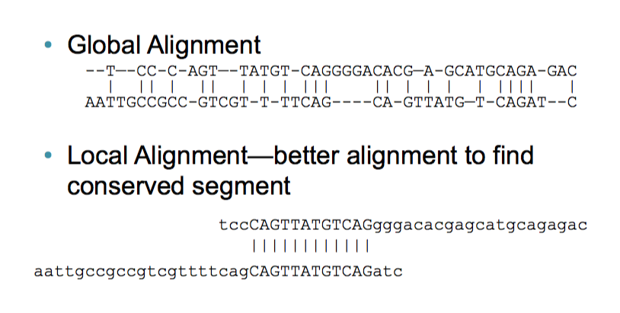
Bioalgorithms.info

Slide 39
Local Alignment using Smith-Waterman(1981)
Just like N-W Except:
Edges are initialized to 0
Maximum score is never less than 0. No pointer unless score recorded
Traceback starts from the highest score in the matrix

Slide 40
N-W matrix
 |  | A | A | G | C | A | T | T | C | C | A
 | 0 | -2 | -4 | -6 | -8 | -10 | -12 | -14 | -16 | -18 | -20
t | -2 | -1 | -3 | -5 | -7 | -9 | -9 | -11 | -13 | -15 | -17
t | -4 | -3 | -2 | -4 | -6 | -8 | -8 | -8 | -10 | -12 | -14
c | -6 | -5 | -4 | -3 | -3 | -5 | -7 | -9 | -7 | -9 | -11
c | -8 | -7 | -6 | -5 | -2 | -4 | -6 | -8 | -8 | -6 | -8
g | -10 | -9 | -8 | -5 | -4 | -3 | -5 | -7 | -9 | -9 | -7
t | -12 | -11 | -10 | -7 | -6 | -5 | -2 | -4 | -6 | -8 | -10
t | -14 | -13 | -12 | -9 | -8 | -7 | -4 | -1 | -3 | -5 | -7
c | -16 | -15 | -14 | -13 | -8 | -9 | -6 | -3 | 0 | -2 | -4
g | -18 | -17 | -16 | -13 | -10 | -9 | -8 | -5 | -2 | -1 | -3
g | -20 | -19 | -18 | -15 | -12 | -11 | -10 | -7 | -4 | -3 | -2

Slide 41
N-W matrix
 |  | A | A | G | C | A | T | T | C | C | A
 | 0 | -2 | -4 | -6 | -8 | -10 | -12 | -14 | -16 | -18 | -20
t | -2 | -1 | -3 | -5 | -7 | -9 | -9 | -11 | -13 | -15 | -17
t | -4 | -3 | -2 | -4 | -6 | -8 | -8 | -8 | -10 | -12 | -14
c | -6 | -5 | -4 | -3 | -3 | -5 | -7 | -9 | -7 | -9 | -11
c | -8 | -7 | -6 | -5 | -2 | -4 | -6 | -8 | -8 | -6 | -8
g | -10 | -9 | -8 | -5 | -4 | -3 | -5 | -7 | -9 | -9 | -7
t | -12 | -11 | -10 | -7 | -6 | -5 | -2 | -4 | -6 | -8 | -10
t | -14 | -13 | -12 | -9 | -8 | -7 | -4 | -1 | -3 | -5 | -7
c | -16 | -15 | -14 | -13 | -8 | -9 | -6 | -3 | 0 | -2 | -4
g | -18 | -17 | -16 | -13 | -10 | -9 | -8 | -5 | -2 | -1 | -3
g | -20 | -19 | -18 | -15 | -12 | -11 | -10 | -7 | -4 | -3 | -2

Slide 42
S-W matrix
 |  | A | A | G | C | A | T | T | C | C | A
 | 0 | 0 | 0 | 0 | 0 | 0 | 0 | 0 | 0 | 0 | 0
t | 0 | 0 | 0 | 0 | 0 | 0 | 1 | 1 | 0 | 0 | 0
t | 0 | 0 | 0 | 0 | 0 | 0 | 1 | 2 | 0 | 0 | 0
c | 0 | 0 | 0 | 0 | 1 | 0 | 0 | 0 | 3 | 1 | 0
c | 0 | 0 | 0 | 0 | 1 | 0 | 0 | 0 | 1 | 4 | 2
g | 0 | 0 | 0 | 1 | 0 | 0 | 0 | 0 | 0 | 0 | 3
t | 0 | 0 | 0 | 0 | 0 | 0 | 1 | 1 | 0 | 0 | 1
t | 0 | 0 | 0 | 0 | 0 | 0 | 1 | 2 | 0 | 0 | 0
c | 0 | 0 | 0 | 0 | 1 | 0 | 0 | 0 | 3 | 1 | 0
g | 0 | 0 | 0 | 1 | 0 | 0 | 0 | 0 | 0 | 2 | 0
g | 0 | 0 | 0 | 1 | 0 | 0 | 0 | 0 | 0 | 0 | 1

Slide 43
S-W matrix
Start traceback at the highest score …
 |  | A | A | G | C | A | T | T | C | C | A
 | 0 | 0 | 0 | 0 | 0 | 0 | 0 | 0 | 0 | 0 | 0
t | 0 | 0 | 0 | 0 | 0 | 0 | 1 | 1 | 0 | 0 | 0
t | 0 | 0 | 0 | 0 | 0 | 0 | 1 | 2 | 0 | 0 | 0
c | 0 | 0 | 0 | 0 | 1 | 0 | 0 | 0 | 3 | 1 | 0
c | 0 | 0 | 0 | 0 | 1 | 0 | 0 | 0 | 1 | 4 | 2
g | 0 | 0 | 0 | 1 | 0 | 0 | 0 | 0 | 0 | 0 | 3
t | 0 | 0 | 0 | 0 | 0 | 0 | 1 | 1 | 0 | 0 | 1
t | 0 | 0 | 0 | 0 | 0 | 0 | 1 | 2 | 0 | 0 | 0
c | 0 | 0 | 0 | 0 | 1 | 0 | 0 | 0 | 3 | 1 | 0
g | 0 | 0 | 0 | 1 | 0 | 0 | 0 | 0 | 0 | 2 | 0
g | 0 | 0 | 0 | 1 | 0 | 0 | 0 | 0 | 0 | 0 | 1

Slide 44
S-W matrix
Alignment = TTCC
TTCC
 |  | A | A | G | C | A | T | T | C | C | A
 | 0 | 0 | 0 | 0 | 0 | 0 | 0 | 0 | 0 | 0 | 0
t | 0 | 0 | 0 | 0 | 0 | 0 | 1 | 1 | 0 | 0 | 0
t | 0 | 0 | 0 | 0 | 0 | 0 | 1 | 2 | 0 | 0 | 0
c | 0 | 0 | 0 | 0 | 1 | 0 | 0 | 0 | 3 | 1 | 0
c | 0 | 0 | 0 | 0 | 1 | 0 | 0 | 0 | 1 | 4 | 2
g | 0 | 0 | 0 | 1 | 0 | 0 | 0 | 0 | 0 | 0 | 3
t | 0 | 0 | 0 | 0 | 0 | 0 | 1 | 1 | 0 | 0 | 1
t | 0 | 0 | 0 | 0 | 0 | 0 | 1 | 2 | 0 | 0 | 0
c | 0 | 0 | 0 | 0 | 1 | 0 | 0 | 0 | 3 | 1 | 0
g | 0 | 0 | 0 | 1 | 0 | 0 | 0 | 0 | 0 | 2 | 0
g | 0 | 0 | 0 | 1 | 0 | 0 | 0 | 0 | 0 | 0 | 1

Slide 45
Exercise
S-W alignment of
Top: ATGCGT
Bottom: GCCCGT
Sub matrix: +1 for match, -1 for mismatch
Gap = -1
Recursion relation:
T(i-1, j-1) + score
T(i-1, j) + gap
T(i, j-1) + gap

Slide 46
Software for making alignments
For N-W and S-W pairwise alignments
pairwiseAlignment() in the “Biostrings” R library
EMBOSS (http://emboss.sourceforge.net/) needle and water programs

Slide 47
Limitations to N-W and S-W
Primarily computational: they work well for short sequences but scale poorly for genome sized alignments
Also the search space (= query length * total length of the letters in the sequences databases) is now too vast

Slide 48
BLAST
Basic Local Alignment Search Tool
Fast
Flexible: many different varieties for nucleotide analysis (BLASTN), proteins (BLASTP), querying nucleotides against protein databases (BLASTX) etc ..
Heuristic algorithm but evaluates results statistically

Slide 49
How BLAST works
Find word hits – seeds. W = length of seed.
Look for T seeds in neighborhood
Extension of seeds – S-W local alignment
Evaluation/Scoring
Statistics to determine whether match is significant

Slide 50
1. Exact word matches (seeds) located
W=3
Query sequence
AAT
|||
AAT
Database sequence
GAC
|||
GAC

Slide 51
2. Seeds within T bases identified
Query sequence
Database sequence

Slide 52
3. Alignments extended
Query sequence
Database sequence

Slide 53
4. Scores calculated, low-scoring pairs removed
High-scoring pair
Query sequence
Database sequence

Slide 54
High Scoring Pair
E (Expectation score)

Slide 55
5. E score for match between query and database sequence calculated
E is the expectation score. E score is the number of similar alignments expect by chance
Based on Karlin-Altschul statistics (1990)

Slide 56
Expectation score for an ungapped local alignment
E = k.mne^{-λS}
(k is a constant)

Slide 57
Expectation score for an ungapped local alignment
E = k.mne^{-λS}
m = query length, n = number of letters in database, therefore mn = query search space

Slide 58
Expectation score for an ungapped local alignment
E = k.mne^{-λS}
S = raw score, λ = normalizing constant, therefore λS
= normalized HSP score

Slide 59
How BLAST parameters affect performance
Larger values of W decreases chance seeds in - the database -> decrease in specificity, increase in speed
(megablast uses long W scores)

Slide 60
How BLAST parameters affect performance
Larger values of T decrease execution time but also decrease sensitivity

Slide 61
How BLAST parameters affect performance
Larger E parameter (which means lower S threshold) increase specificity at the cost of sensitivity

Slide 62
Further Reading
Practical on pairwise alignment in R in the Little Book of R for Bioinformatics:
https://a-little-book-of-r-for-bioinformatics.readthedocs.org/en/latest/src/chapter4.html
The Statistics of Sequence Similarity Scores
http://www.ncbi.nlm.nih.gov/BLAST/tutorial/Altschul-1.html
Dewey, C. N. Whole-genome alignment. Methods Mol. Biol. 855, 237–257 (2012).

Slide 63
Whole Genome Alignment (WGA)
Vital for many downstream genomewide comparisons – e.g. building phylogenies, detecting positive selection and recombination

Slide 64
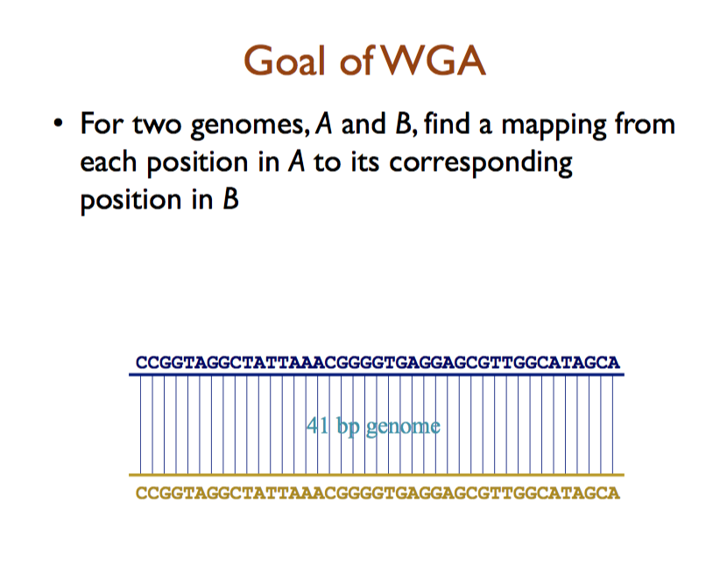
Adam Phillipy

Slide 65
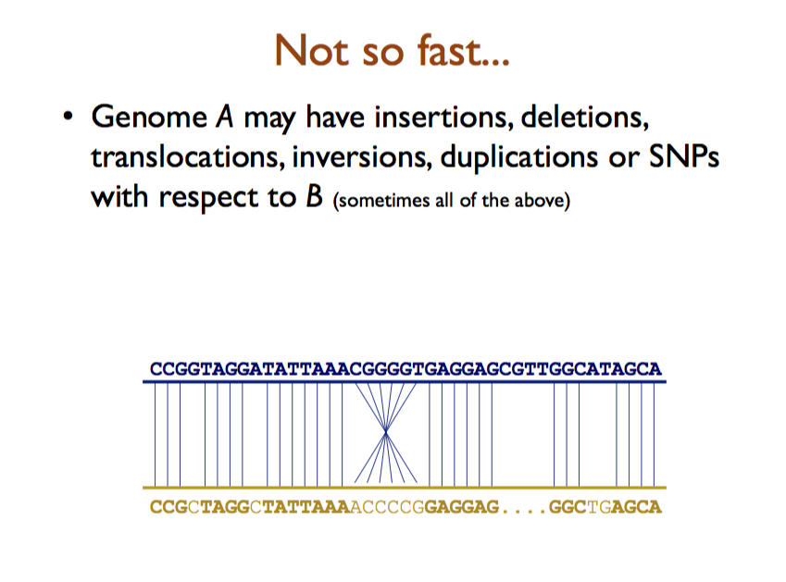
Adam Phillipy

Slide 66
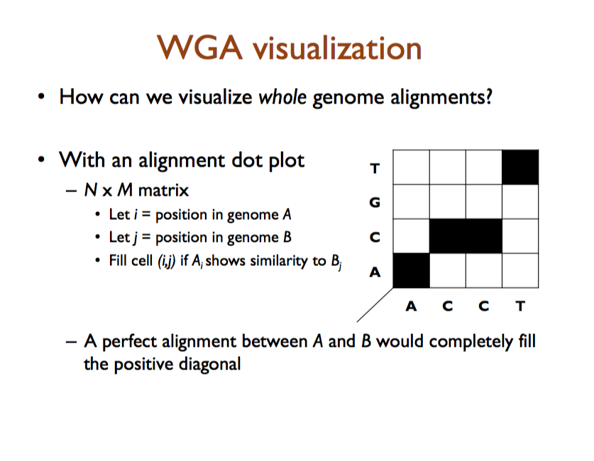
Adam Phillipy

Slide 67
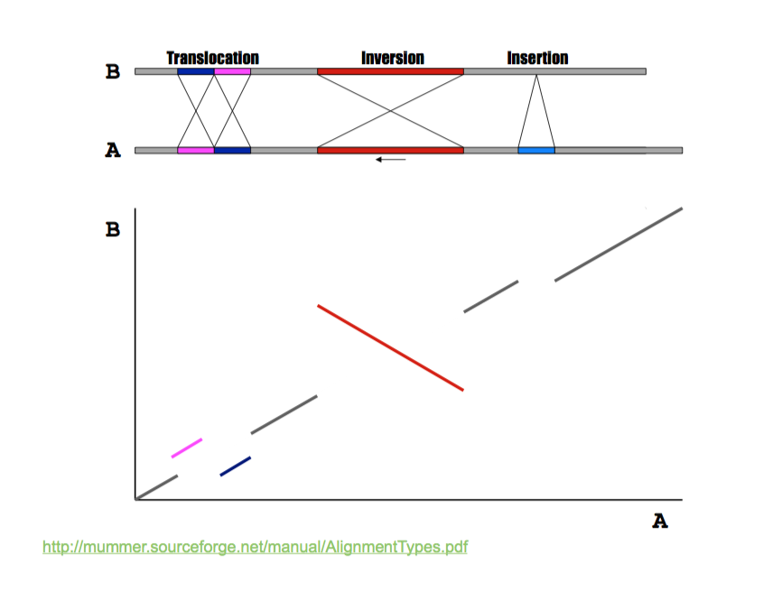
Adam Phillipy

Slide 68
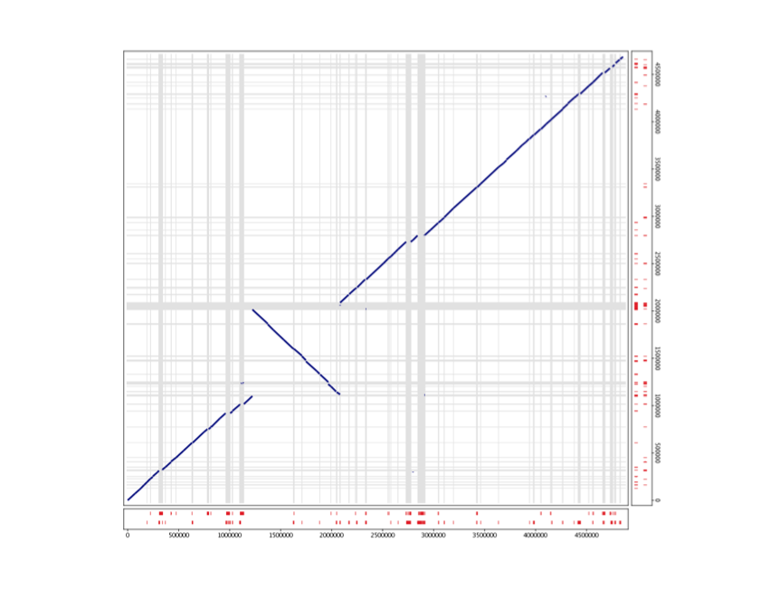
Adam Phillipy

Slide 69
The simplest approach - BLASTN for whole genome alignment
Can use megablast – optimized for rapid alignment of large, very similar sequences
Large word size (W = 16 +) highly specific, low sensitivity
DNA alignment optimized for speed.
Will only produce genome-wide alignment for highly similar, co-linear, sequences
What if you want to compare multiple genomes?

Slide 70
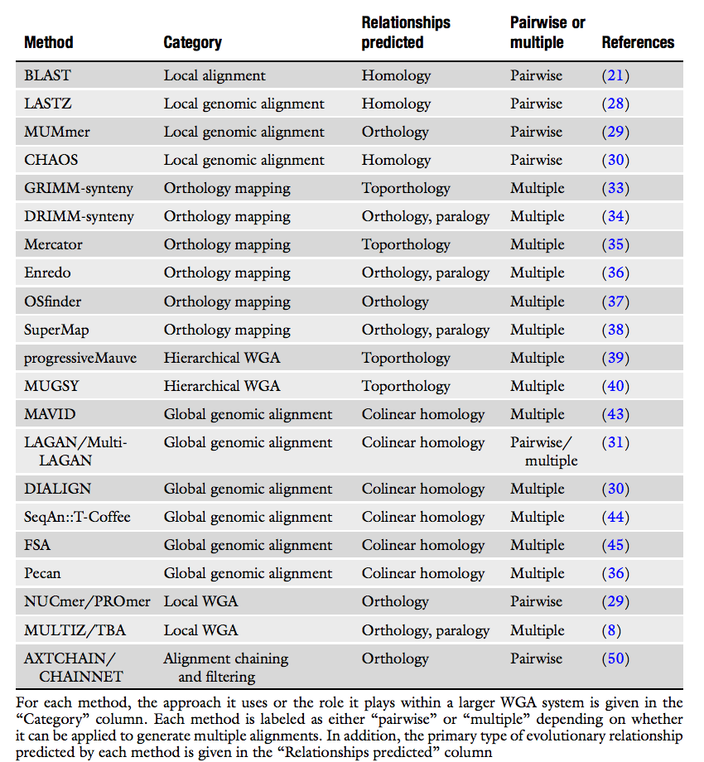
A plethora of WGA Software
Dewey, C. N. Whole-genome alignment. Methods Mol. Biol. 855, 237–257 (2012).

Slide 71
Tradeoffs
Each software is a tradeoff between trying to achieve multiple goals
Execution speed
Multi-genome alignment – how many genomes
Sensitivity – what proportion of the genomes are aligned
Specificity (aka accuracy) – how confident are we that the matches are real

Slide 72
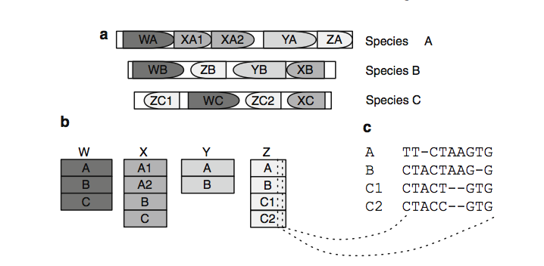
Alignment blocks
Many WGA programs decompose genomes into locally similar blocks
Dewey, C. N. Whole-genome alignment. Methods Mol. Biol. 855, 237–257 (2012).

Slide 73
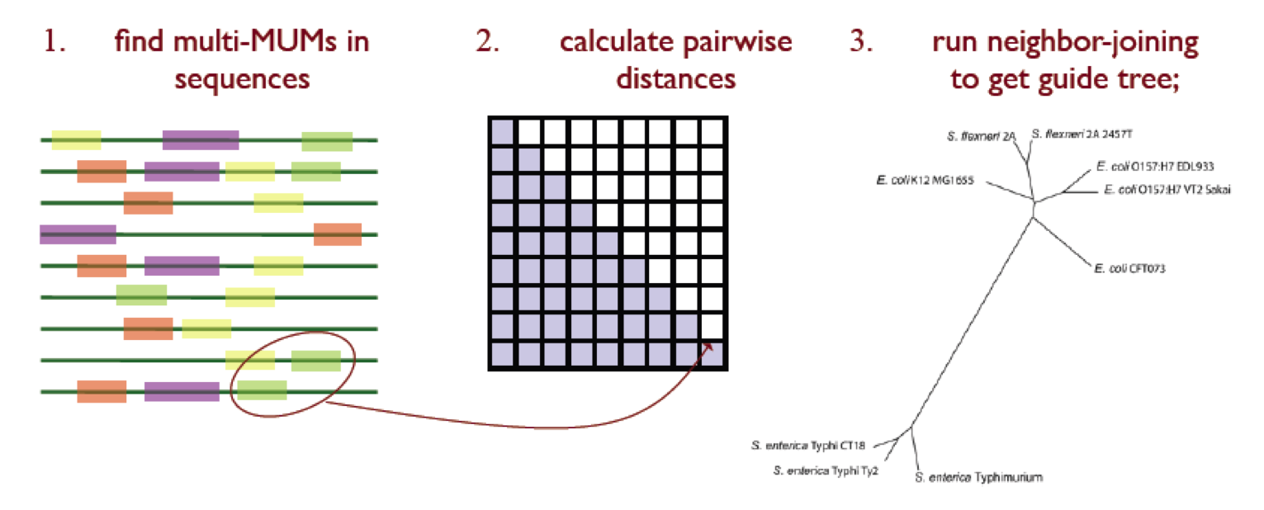
Guidetrees
Hierarchical aligners compare most similar genomes first for increased efficiency
Colin Dewey

Slide 74
An example: progressiveMAUVE
Does not assume that genomes are colinear
Looks for positional homology multiple genome alignments
Calculates pairwise locally colinear blocks – “a set of local alignments that occur in the same order and orientation in a pair of genomes”
Darling, A. E., Mau, B. & Perna, N. T. progressiveMauve: multiple genome alignment with gene gain, loss and rearrangement. PLoS One 5, e11147 (2010).

Slide 75
MAUVE algorithm
Find local alignments (multi-MUMs).
Use the multi-MUMs to calculate a phylogenetic guide tree.
Select a subset of the multi-MUMs to use as anchors—these anchors are partitioned into collinear groups called LCBs.
Perform recursive anchoring to identify additional alignment anchors within and outside each LCB.
Perform a progressive alignment of each LCB using the guidetree.

Slide 76
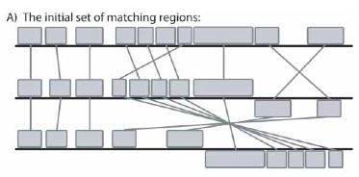
Mauve 1
Darling, A. C. E., Mau, B., Blattner, F. R. & Perna, N. T. Genome Res. 14, 1394–1403 (2004).

Slide 77
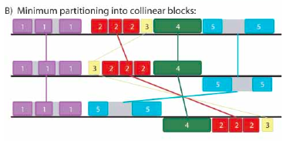
Mauve 2

Slide 78
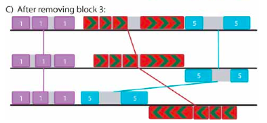
Mauve 3
Recursively remove weakest MUMs and coalesce colinear blocks to remove breakpoints

Slide 79
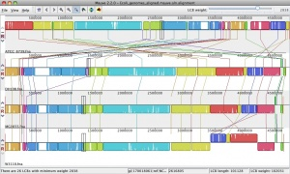
Mauve example: E. coli genomes
ecoliwiki

Slide 80
Another WGA software: MUMmer - Suffix tree-based homology
Designed for fast alignment of large, closely related sequences
Assumption: There is a mapping between large subsequences of the two inputs
Limitations: Only two genomes at the time
A.L. Delcher, et al., 1999, Nucleic Acid Research.

Slide 81
MUMmer
Identify all MUMs
A Maximal Unique Match is a subsequence that occurs exactly (100% identity) once in Genome A and once in Genome B, and is not contained in any longer such sequence
Use the suffix tree data structure for efficiency for both run time and space
Extract the longest set of matches that occur in the same order in both genomes

Slide 82
Suffix tree
A suffix tree is a compact representation that stores all possible suffixes of an input sequence S
A suffix is a subsequence that begins at any position in the sequence and extends to the end of the sequence
G A A C C G A C C T
1 2 3 4 5 6 7 8 9 10
0
A
C
GA
T
1
1
2
10
ACCGACCT
CC
GACCT
C
T
ACCGACCT
CCT
2
3
5
2
9
1
6
GACCT
T
GACCT
T
3
7
4
8

Slide 83
MUMmer Pros/Cons
Pros
Very fast for alignment of genomes of different strains of the same species or genomes of similar species
Can handle long insertions and deletion
Can detect inversion, SNPs, repeat and tandem repeats
Cons
Speed suffer significantly for less similar sequences
Minimum MUM length needs to be set lower

Slide 84
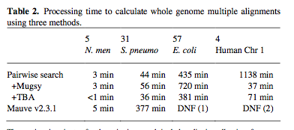
MUGSY
MUMmer optimized for multiple genomes
Anguioli and Salzberg Bioinformatics 2011 vol. 27 (3) pp. 334-42

Slide 85
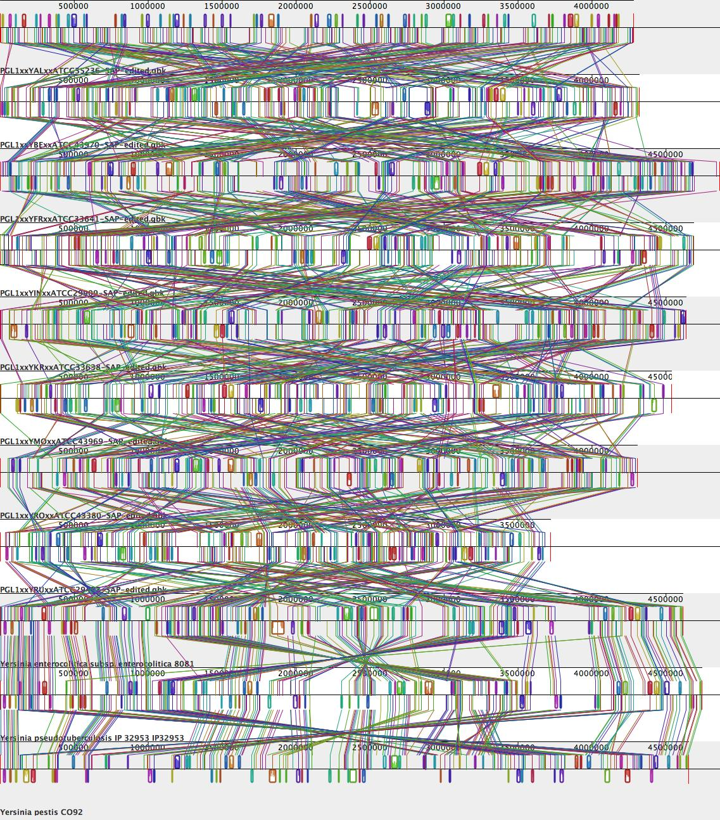
Problems with WGA
Most WGA software has no explicit evolutionary model
Grows exponentially slower with each new genome
Incomplete sequences?
Visualization issues

Slide 86
Evaluation – how to compare WGA tools?
Descriptive Statistics:
Run time
“Coverage” = fraction of the genome aligned
“Core position” = positions with gap free alignments for all members

Slide 87
Summary Concepts
Needleman-Wunsch and Smith-Waterman algorithms provide optimal global and local alignment solutions
BLAST is a heuristic algorithm that allows alignment of sequences to large databases
WGA algorithms are heuristic and are often built on post-processing of smaller local alignment regions

Slide 88
Post WGA analysis
Some ways to view and use the outputs of whole genome alignments

Slide 89
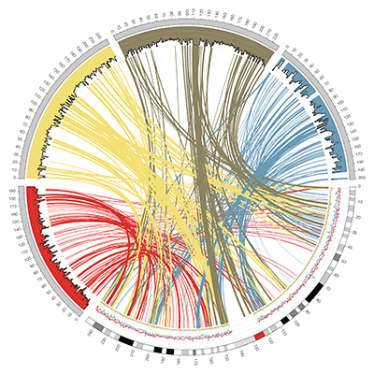
Circos visualization
http://circos.ca/

Slide 90
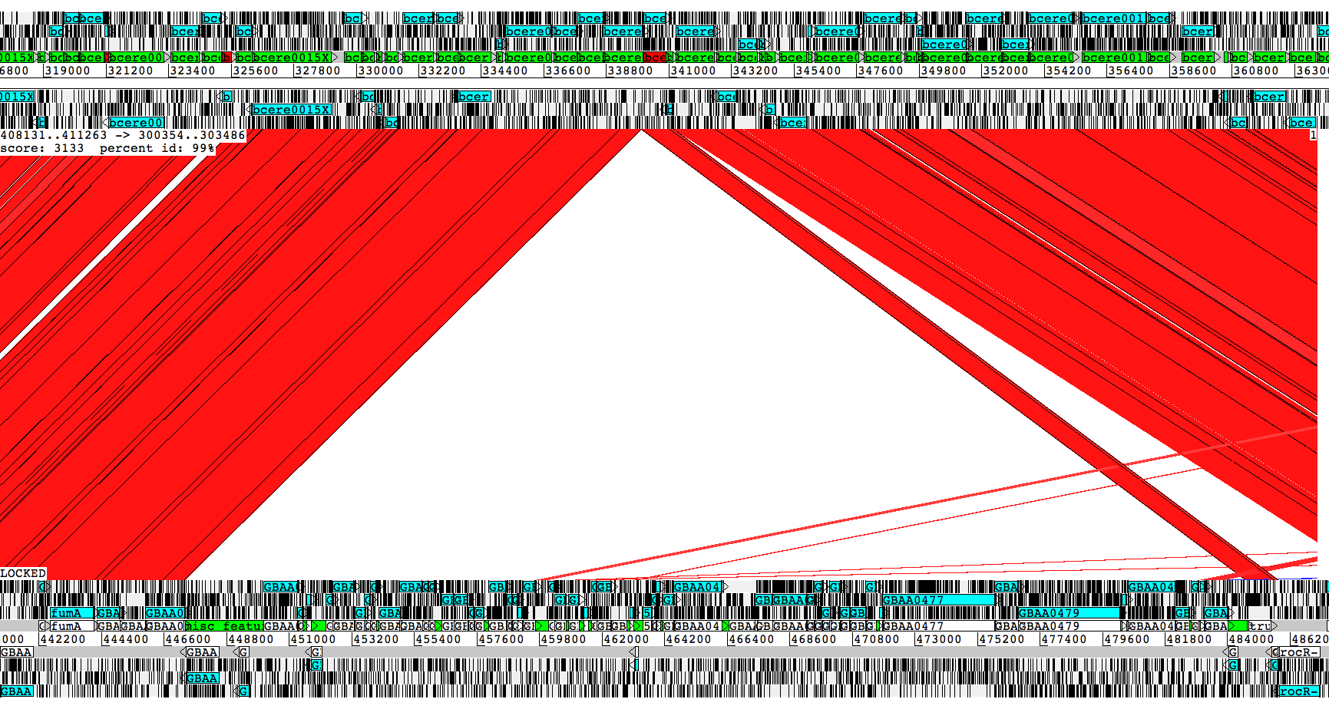
Investigating whole genome alignments using Artemis Comparison Tool
http://www.sanger.ac.uk/resources/software/act/
B. cereus
B. anthracis

Slide 91
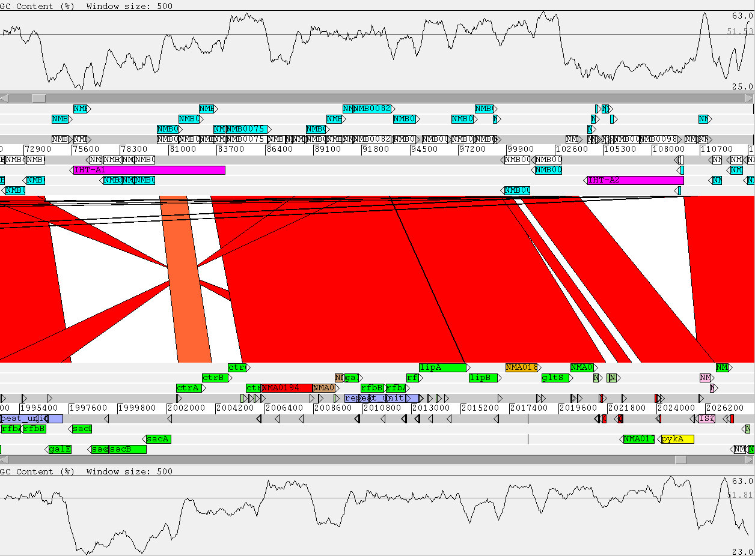
Genome Comparison using Artemis
Neisseria meningitidis MC58 (serogroup B) versus Neisseria meningitidis Z2491 (serogroup A)

Slide 92
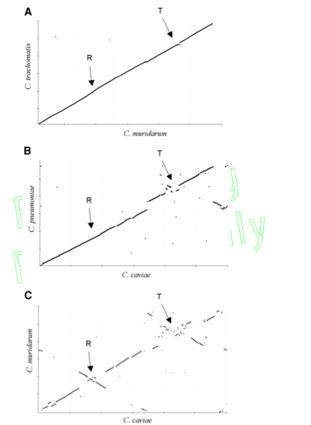
Plotting genome rearrangements over evolutionary time using WGA
16S identity
99%
97%
95%

Slide 93
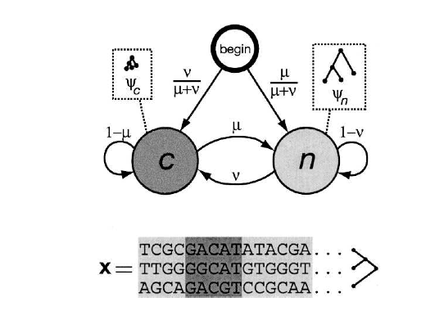
phastCons
Extracts significant significant regions of conservation across the genome based on phylogeny
HMM based model of multi-genome alignment (produced in this case by the MULTIZ aligner program)
Siepel et al Genome Research 2005 vol. 15 (8) pp. 1034-50
Notes:
Human FOXP2 gene and evolutionary conservation is shown in and multiple alignment (at bottom of figure) in this image from the UCSC Genome Browser. Note that conservation tends to cluster around coding regions (exons). (Wikipedia)

Slide 94
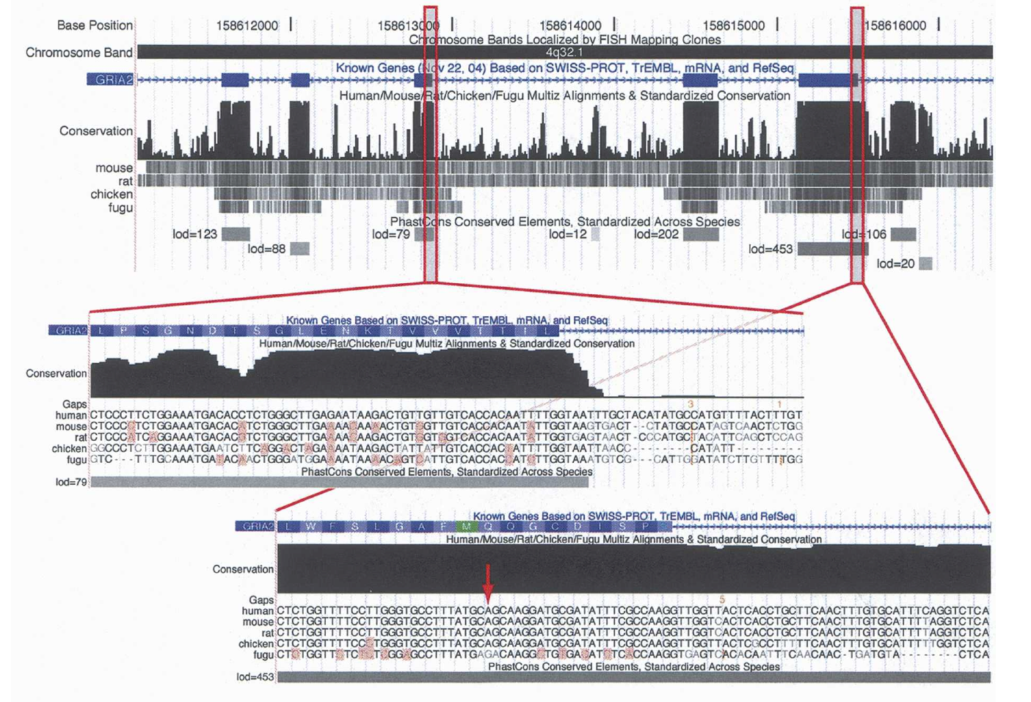
phastCons

